Slide 1


Programming Fundamentals
Aamina Batool

Slide 2
cin.ignore()
 cin.ignore()
 is used to skip the very next character.
 cin.ignore(100, '\n’);
 it ignores either the next 100 characters or all characters until the newline character is found, whichever comes first. For example, if the next 120 characters do not contain the newline character, then only the first 100 characters are discarded and the next input data is the character 101.
 cin.ignore(100, 'A’);
 results in ignoring the first 100 characters or all characters until the character 'A’ is
found, whichever comes first.

Slide 3
get and getline functions
 | char | str1[26];
 | char | str2[26];
 | char | discard;
 two lines of input:
 Summer is warm.
 Winter will be cold.
 Both str1 and str2 can store C-strings that are up to 25 characters in length. Because the number of characters in the first line is 15, the reading stops at '\n'. Now the newline character remains in the input buffer and must be manually discarded.
 cin.get(str1, 26);
 cin.get(discard);
 cin.get(str2, 26);
 We can also use cin.ignore() here to dicard newline character from
the buffer

Slide 4
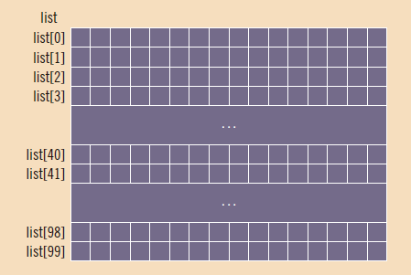
2-D Character Arrays
 char list[100][16];

Slide 5
Inputting/outputting char 2-d arrays
 Suppose that you want to read and store data in list and that there is one entry per line.
 The following for loop accomplishes this task:
for (int j = 0; j < 100; j++) cin.get(list[j], 16);
 The following for loop outputs the string in each row:
for (int j = 0; j < 100; j++)
cout << list[j] << endl;
 You can also use other string functions (such as strcmp
and for loops to manipulate list.
and strlen)

Slide 6
Reading/writing data from/to a list and there is one entry per line
char list[100][16];
for (int i=0; i< 100; i++)
{
cin.get(list[i], 16);
cin.ignore();
cout << “iteration no. is: “ << i + 1<< endl;
cout << “input read in this iteration is: “<< endl; cout << list[i] << endl;
}
Task:
Comment out the second statement of loop see what input is stored in list.
Use getline instead of get and see if you still need to use cin.ignore() or not.

Slide 7
Palindrome
 A palindrome is a string, which when read in both forward and backward ways is the same.
 Example: pop, radar, madam, etc.

Slide 8
Palindrome
char list[20] = { ‘m’ , ‘a’ , ‘d’, ‘a’, ‘m’ , ‘\0’ } int flag = 0;
int length = strlen(list); for(i=0;i < length ;i++)
{
If (list[i] != list[length-i-1])
{ flag = 1; break; }
}

Slide 9
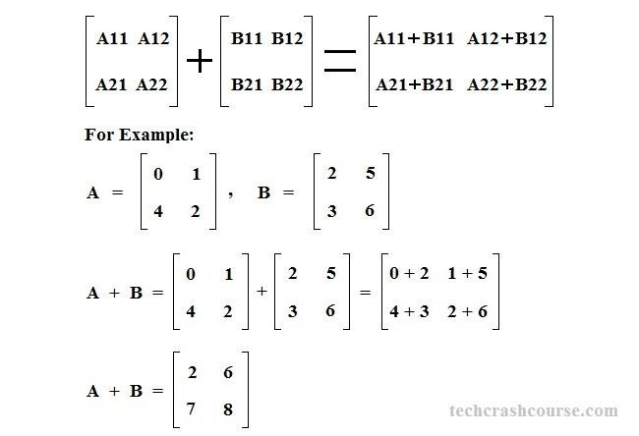
Matrix Addition

Slide 10
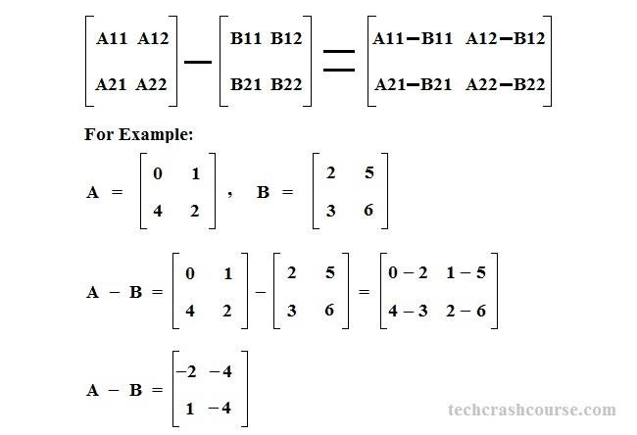
Matrix Subtraction

Slide 11
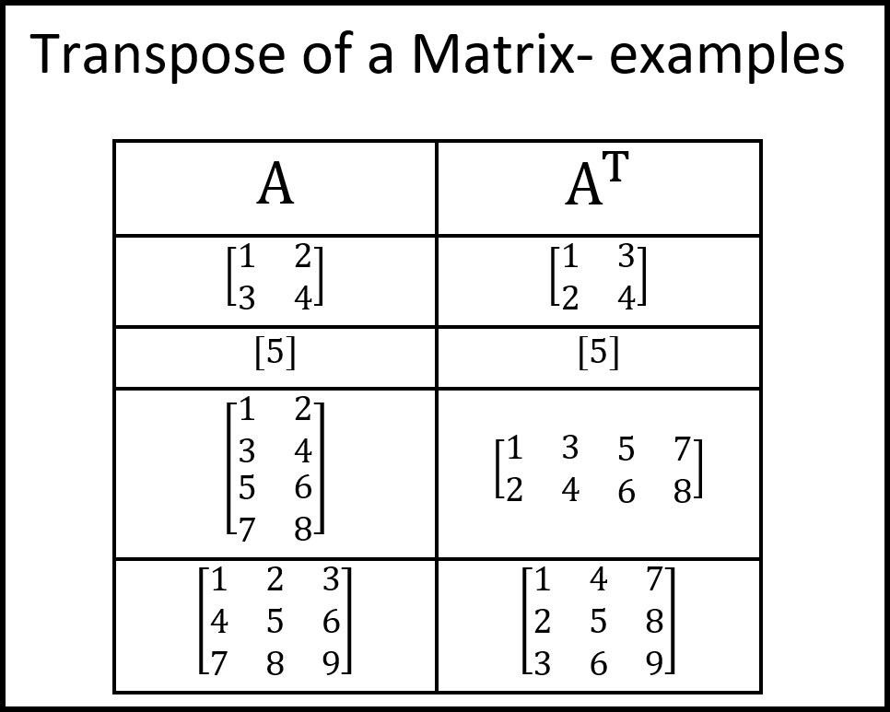
Matrix Transpose

Slide 12
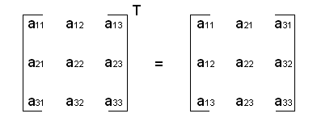
Matrix Transpose

Slide 13
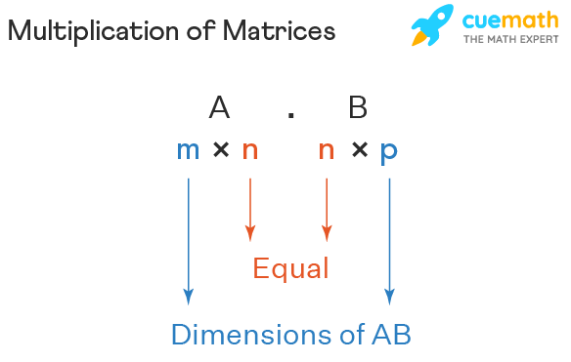
Matrix Multiplication

Slide 14
Matrix Multiplication

Slide 15
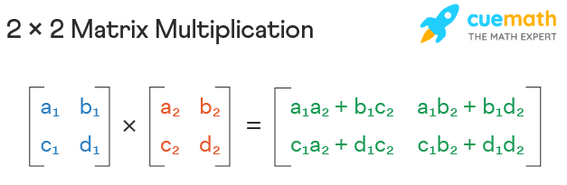
Matrix Multiplication

Slide 16
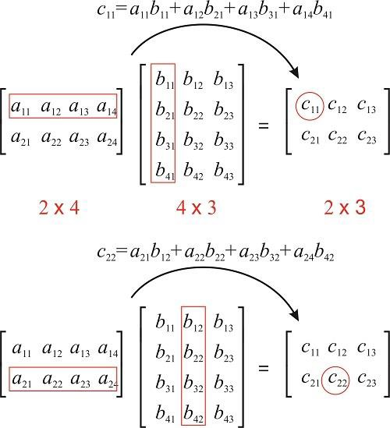
Matrix Multiplication

Slide 17
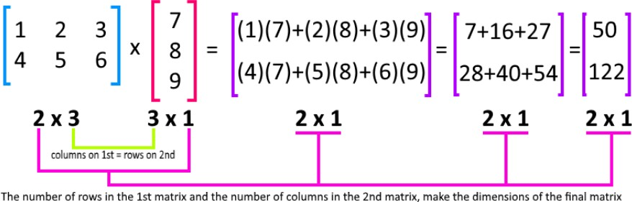
Matrix Multiplication

Slide 18
Matrix Multiplication
 The algorithm for multiplication of matrices A with order m*n and B with order n*p can be written as:
for i from 0 to m-1
for j from 0 to p-1
^{c}ij
= 0
for k in 1 to n
^{c}ij
+= a_{ik}*b_{kj}

Slide 19
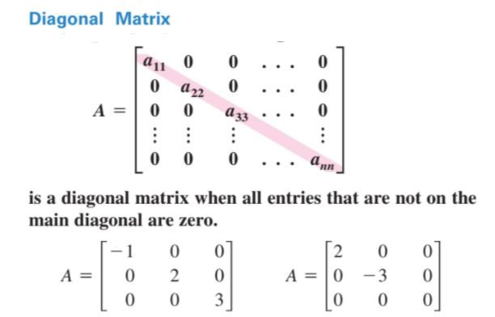
Diagonal Matrix

Slide 20
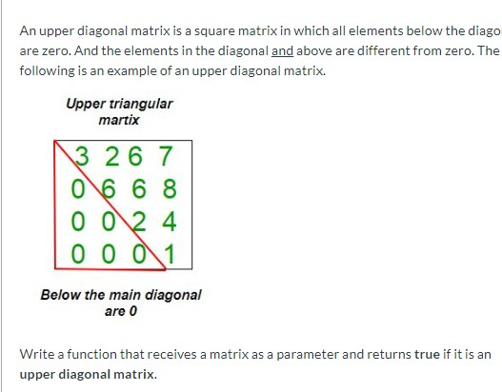
Upper triangular matrix
Task: Also study lower triangular matrix.

Slide 21
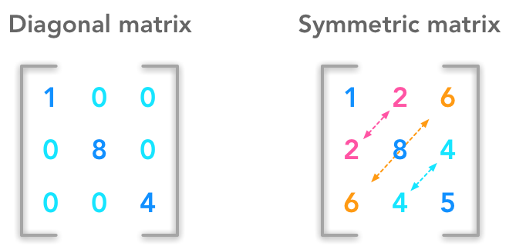
Symmetric Matrix

Slide 22
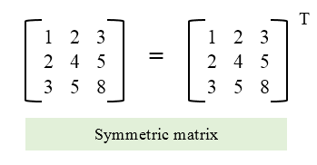
Symmetric Matrix
(transpose of matrix is same as original matrix)

Slide 23
Exercises
 C++ Program to store temperature of two different cities for a week and display it.
 Find Column/Row wise max, min, average, sum.
 Sort the array Row/Column wise.
 Write a program for adding two matrices of size 2x2, take input from the user.
 Write a program for multiplying two matrices of size 2x2, take input from the user.
 Write a program to find transpose of a 3x3 matrix and a 3x2 matrix.
 Write a program to find inverse of a 2x2 matrix.

Slide 24
References
C++ Programming: From Problem Analysis to Program Design, Third Edition
https://www.just.edu.jo/~yahya-t/cs115/

